Slide 1

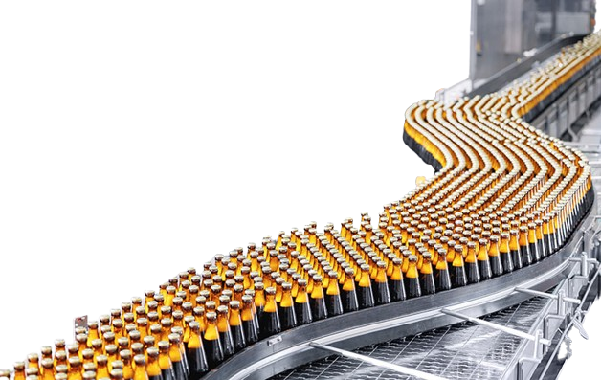

MANUFACTURING DOWNTIME ANALYSIS
A Look Into the Causing Factors, their Frequency, and patterns in a Beverage Factory.

Slide 2



PRESENTED BY:
Anas Ashraf Helmy
Fatma Abdelrahman Mahmoud
Farah Khaled Mostafa
Salwa Sayed Ibrahim
Manar Fathy Hassan
Rasha Mahmoud Hassan
2

Slide 3


INTRODUCTION
Project Objective:
-Analyzing manufacturing downtime data using Power BI to clarify the causes and improve production efficiency.
The importance of downtime analysis in improving production efficiency
What is Manufacturing Downtime?
3

Slide 4
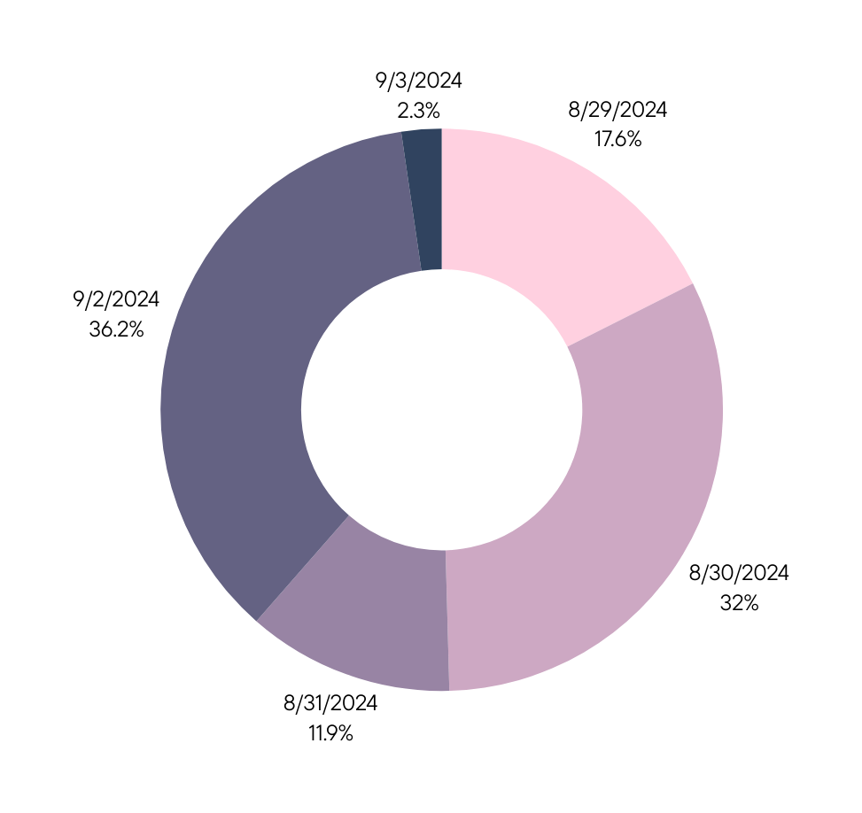
REFERENCE PERIOD
& DOWNTIME
The Data was based on a period of 5 days inside the Soda factory.
From 29\8\2024 to 3\9\2024
Downtime accounted for a total of 1388 minutes!
Our Analysis focused on the factors, their frequency and the underlying reasons of that!
4

Slide 5

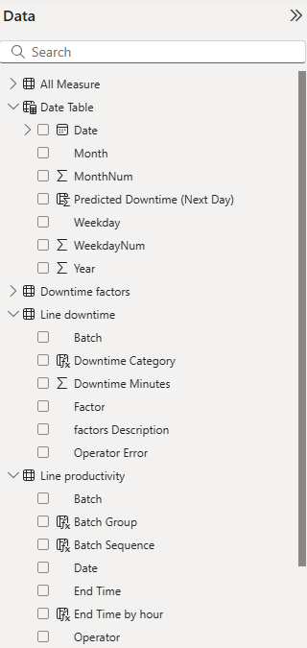
DATA USED
Production data
Downtime data
Causing factors data
Operators' data
KEY FIELDS
Date
Downtime
Duration
Production Duration
Contributing Factors
Responsible Operator
5

Slide 6

KEY ANALYTICAL QUESTIONS
What percentage of Total Production Time is Downtime?
What are the most frequent Downtime Factors?
How do different factors impact productivity?
What are the Operators Contribution to the Downtime?
What are the predicted Future Downtime Rates? And how can they be offset?
6

Slide 7

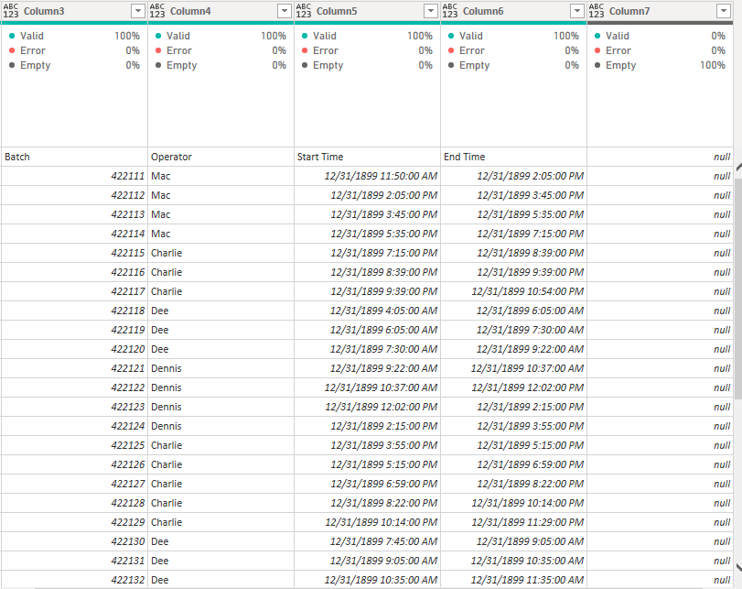
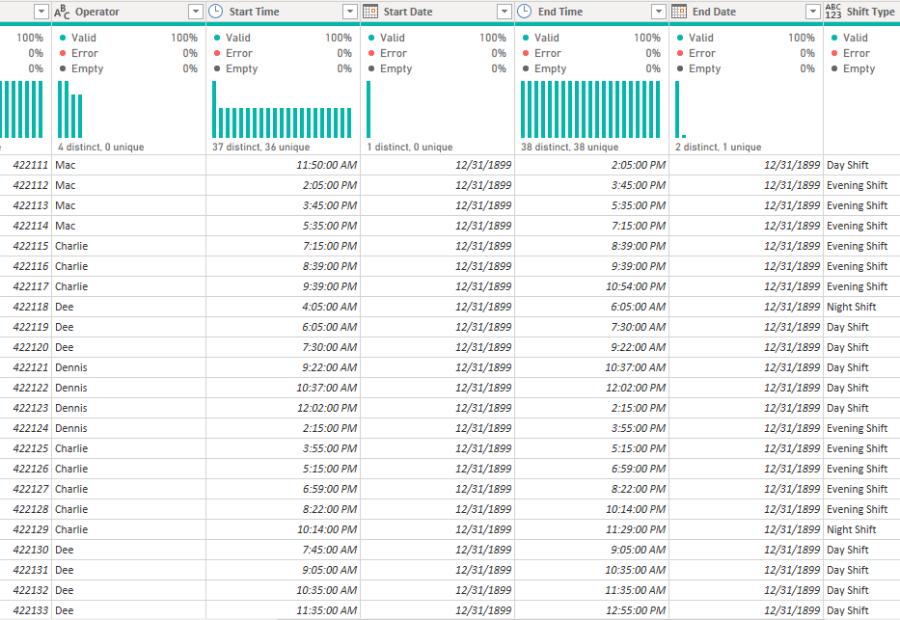
DATA CLEANING
BEFORE
AFTER
7

Slide 8
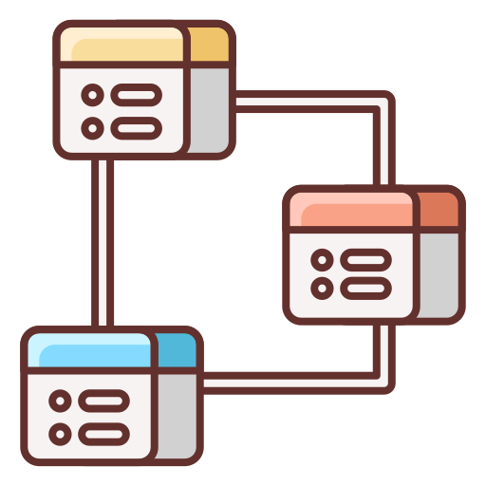
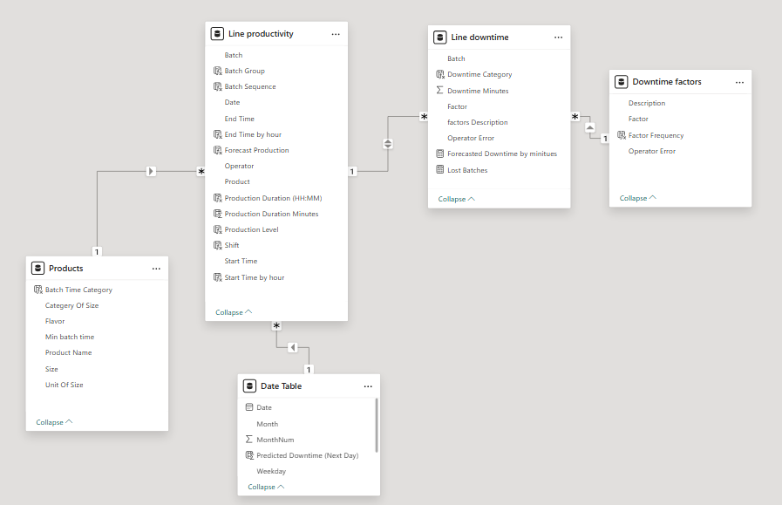
DATA MODELING
7

Slide 9


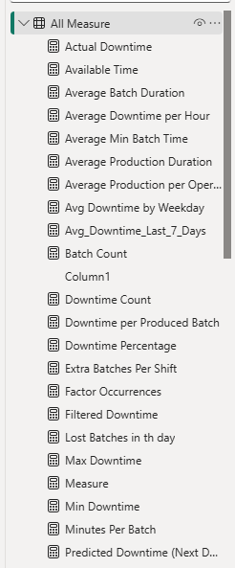
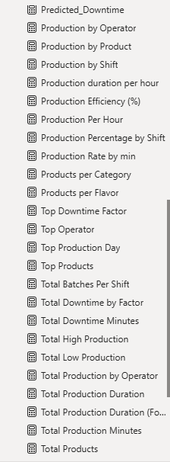
DAX & MEASURES
=GROUPBY(
=AVERAGE(
=IF(
=FORMAT(
=COUNT(
=TOPN(
=COUNTROWS(
=CONCATENATEX(
=CALCULATE(
=MAX(
=SUM(
=DIVIDE(
7

Slide 10


DASHBOARD
9

Slide 11


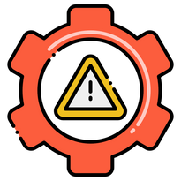






KEY
FINDINGS
Total Downtime
Downtime Percentage
Number of Factors
Number of Downtime Incidents
1388 Mins
1388 Mins
26.5%
12 Factors
61
Most Occurring
Factor
Percentage of Operators Errors
Top
Product
Predicted Downtime Percentage
Machine
Adjustment
52%
CO-600
22.7%

Slide 12

RECOMMENDATIONS
For a more efficient batch run
Enhance preventive measures to reduce unexpected downtimes.
Train operators to handle technical issues more efficiently.
Use predictive models to estimate future downtimes based on historical data.
Increase real-time monitoring of the production line, to detect faults before they occur.
10

Slide 13
THANK YOU FOR LISTENING!
Feel free to Ask any questions!

